Slide 1





NETWORKS AND GRAPHS IN R FOR BIOLOGY
March 13, 2021
09:00 am - 11:00 am (UTC)

Slide 2
Agenda
Time (EAT/ GMT+3) | Duration | Activity | Responsible Group/ Person
12:00 pm - 12:05 pm | 5 minutes | Participants join
12:05 pm - 12:10 pm | 5 minutes | Welcoming participants and outlining agenda | R-Ladies Nairobi
12:10 pm - 12:20 pm | 10 minutes | Introduction of the collaborating groups and organisers | R-Ladies Abuja
12:20 pm - 12:25 pm | 5 minutes | Introducing the speaker | R-Ladies Tunis
12:25 pm - 13:25 pm | 60 minutes | Talk | Dr. Susan Holmes
13:25 pm - 13:55 pm | 30 minutes | Q & A | R-Ladies Jozi
13:55 pm - 14:00 pm | 5 minutes | Launch of R-Ladies Africa/ closing remarks | R-Ladies Algiers

Slide 3
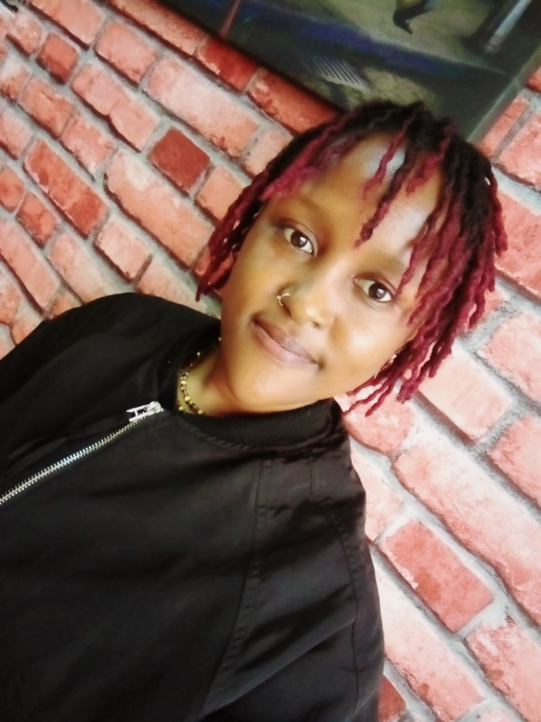
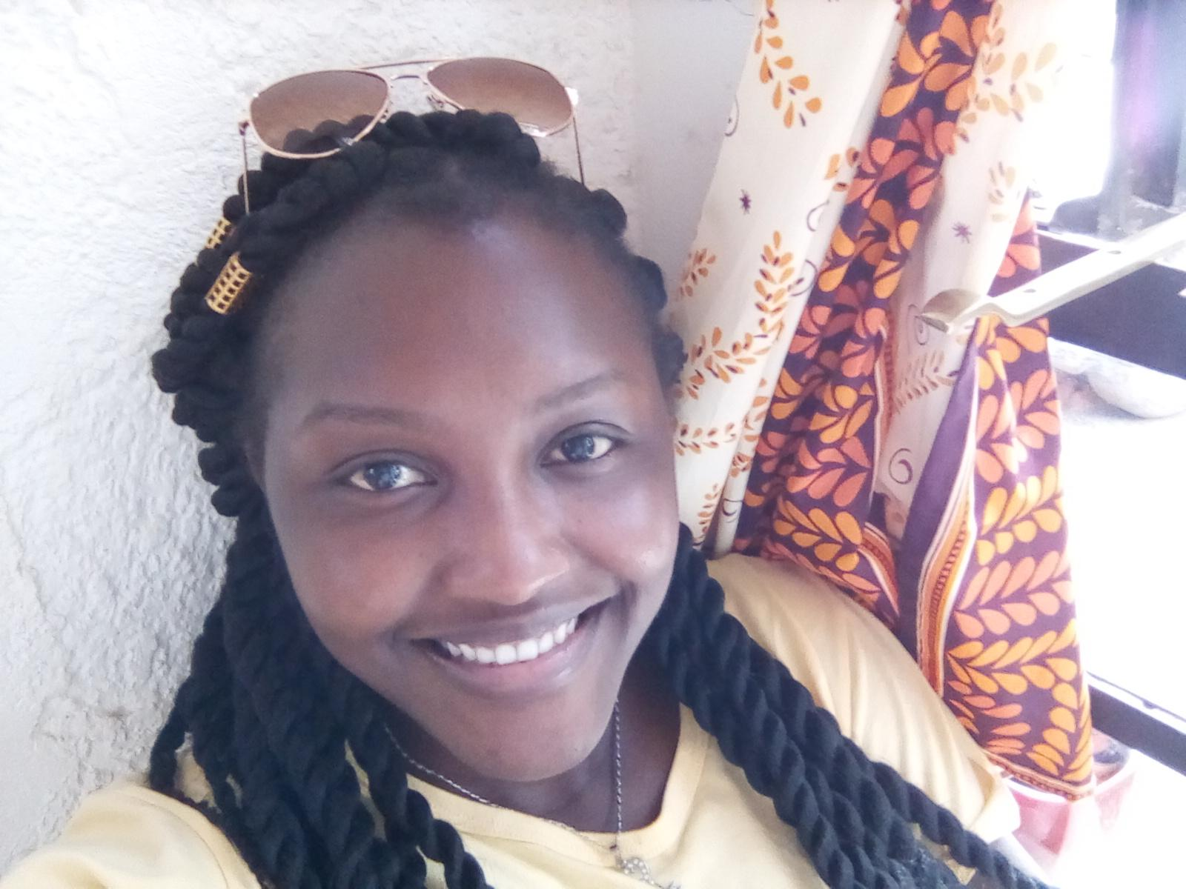
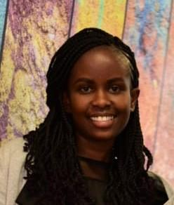
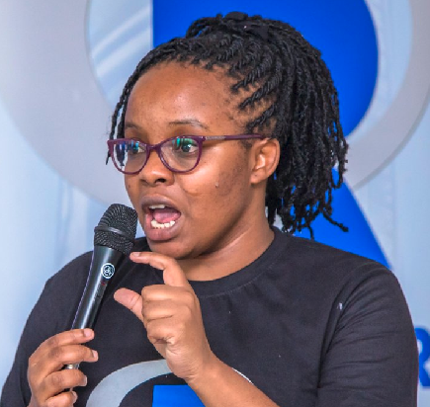
R-Ladies Nairobi Organizers
Lucy Njoki
Margaret Wanjiru
Faith Musili
Shelmith Kariuki
Biostatistician
Financial Risk Analyst
Senior Data Analyst
Senior Data Analyst , Co-organizer- AfricaR & NairobiR

Slide 4
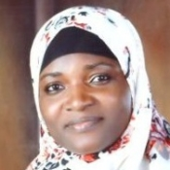
R-Ladies Abuja Organizers
Bilikisu Wunmi Aderinto
Business Data Analyst

Slide 5

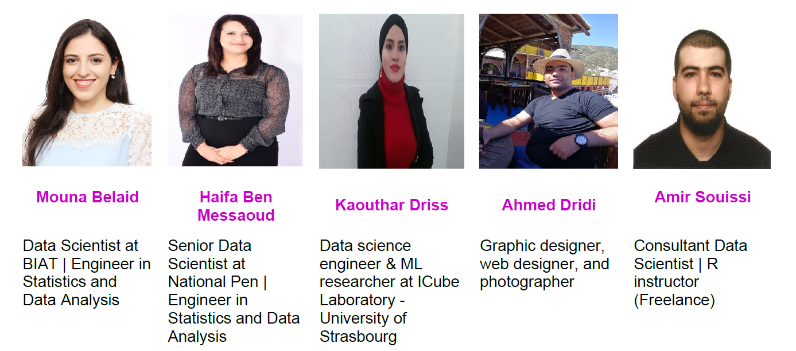
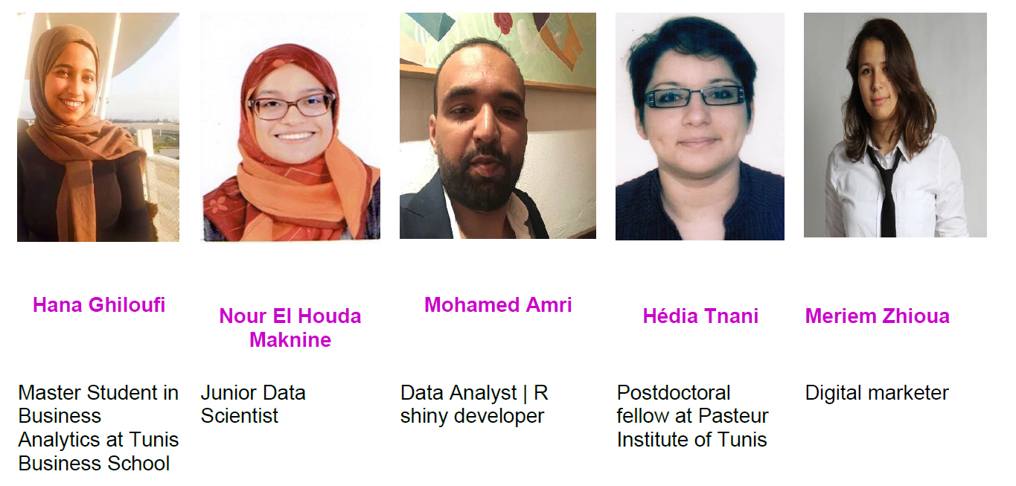
R-Ladies Tunis Organizers

Slide 6
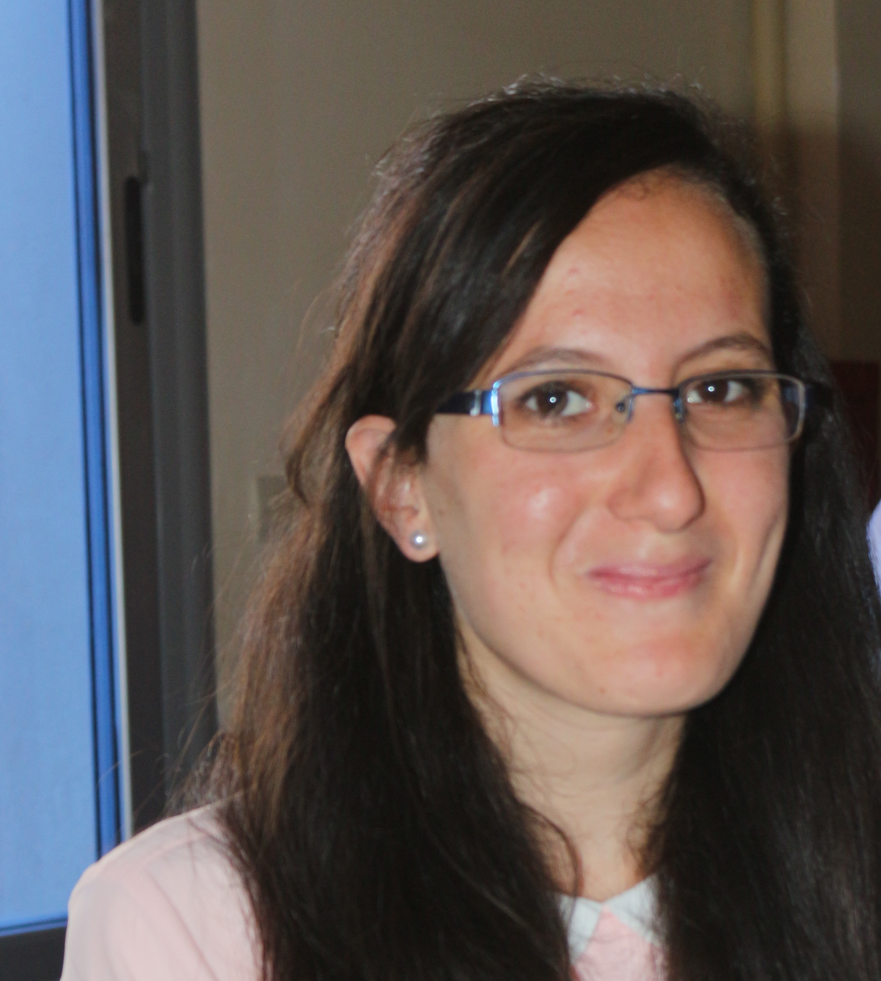
R-Ladies Algiers Organizers
BENADROUCHE Kamila
Economic studies Engineer

Slide 7
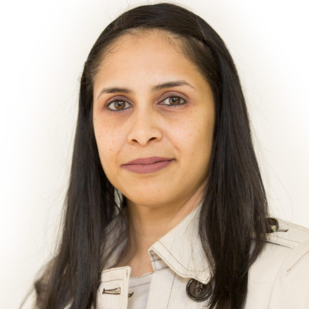
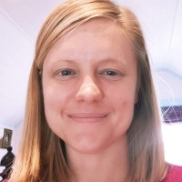
R-Ladies Jozi Organizers
Vebashini Naidoo
rain South Africa
Inger Fabris-Rotelli
University of Pretoria

Slide 8

Our Trainer
Dr. Susan Holmes
Professor of Statistics at Stanford University

Slide 9
Training Session

Slide 10
Q & A

Slide 11

Launch of R-Ladies Africa

Slide 12
Thank you on behalf of

